Slide 1
Oral-gut bacterial translocation
Chen Liao, Ph.D.
Xavier lab meeting
08/18/2022

Slide 2
Allo-HCT (hematopoietic cell transplantation) patient
Prophylactic antibiotic/antifungal/antiviral treatment
Conditioning
Infusion
Engraftment
Pre-engraftment
-7 d
0
14-21
30-90
Immunocompromised
Loss of Mucosal Integrity
Microbial Dysbiosis (GI tract)
Bacterial/Fungal/Viral
Infections

Slide 3
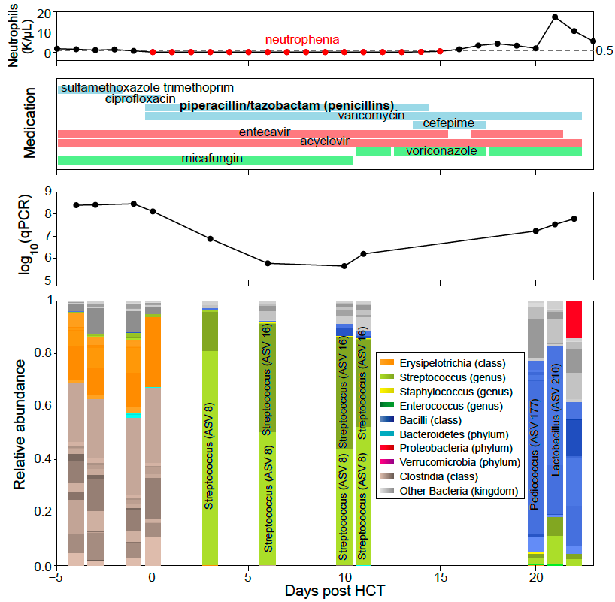
Are Streptococcus ASVs translocated from oral cavity?

Slide 4
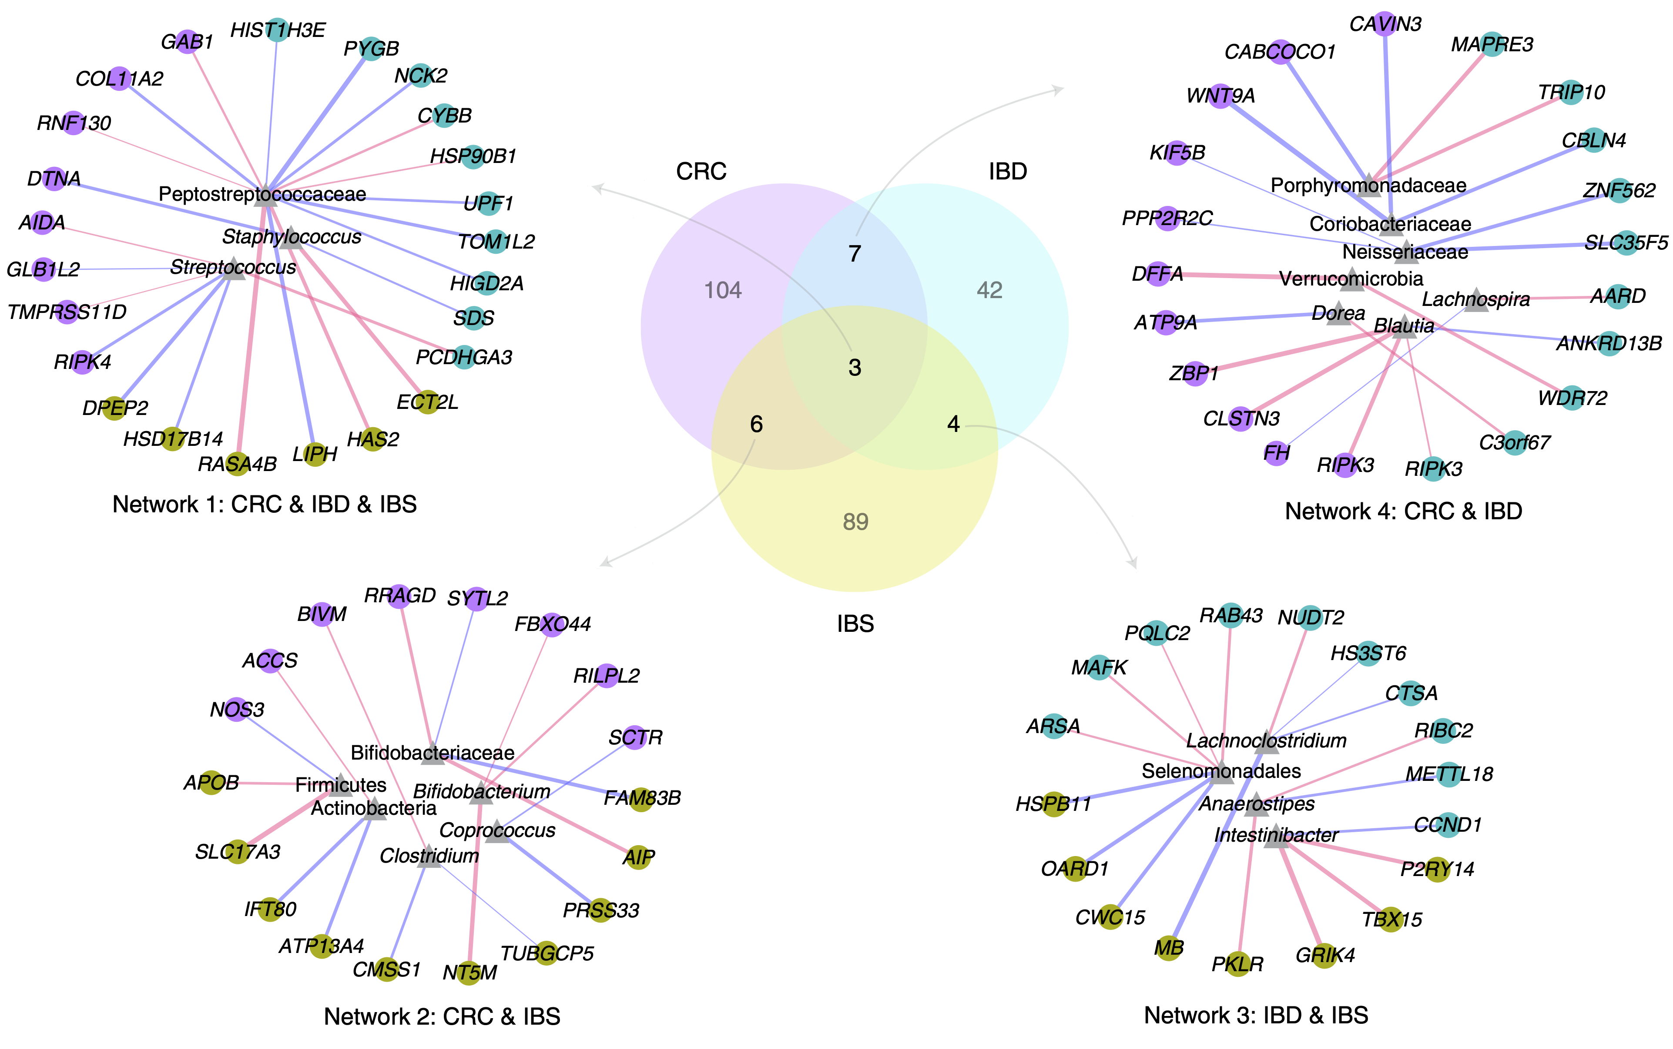
Streptococcus associated with host genes in gut diseases
Association between gut mucosal microbes and host transcriptomics (Priya et al, Nat. Microbiol., 2022)

Slide 5
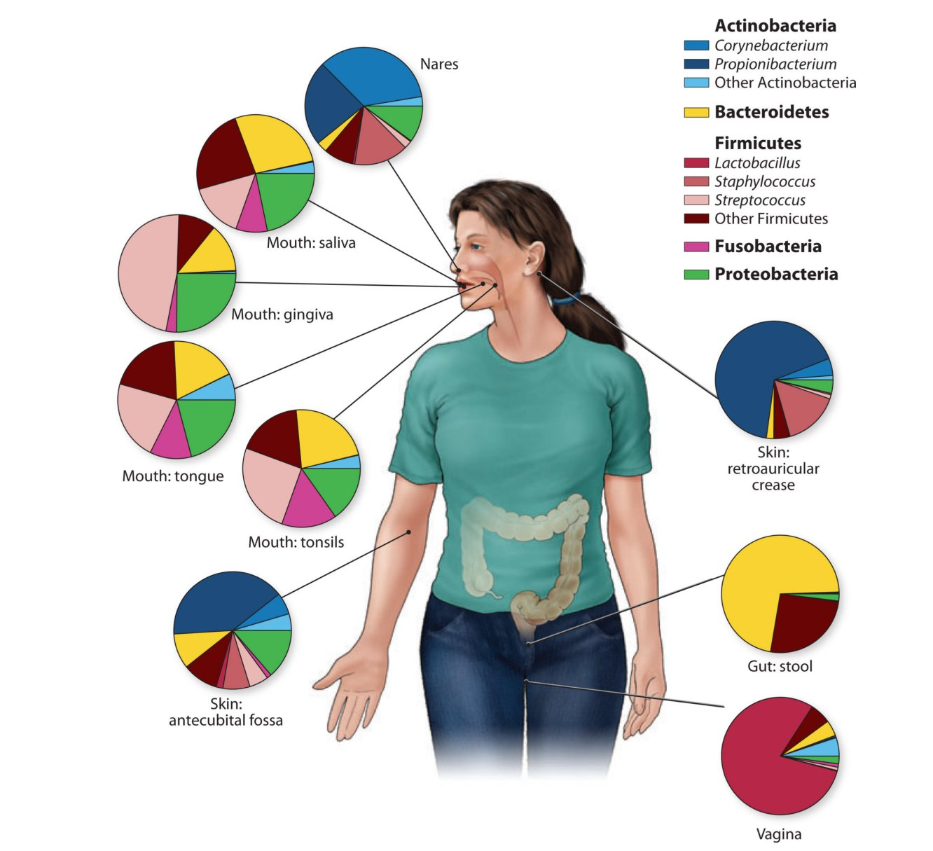
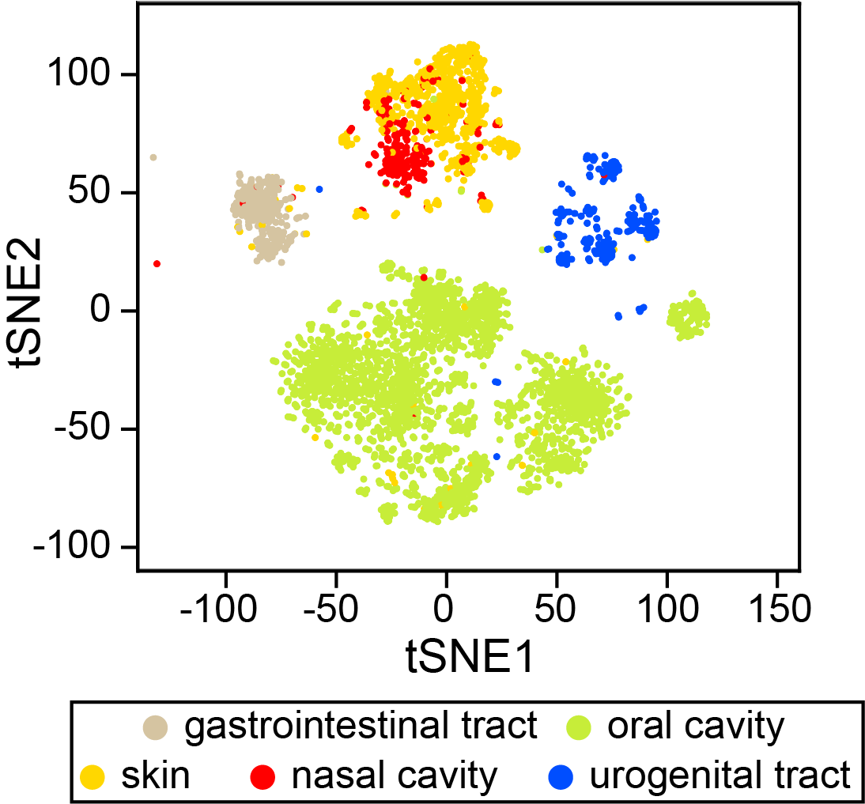
Human microbiome is niche-specific
https://unlockinglifescode.org/explore/genomic-medicine/microbiome

Slide 6

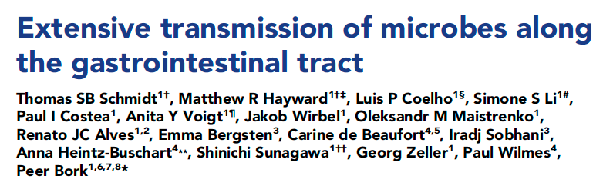

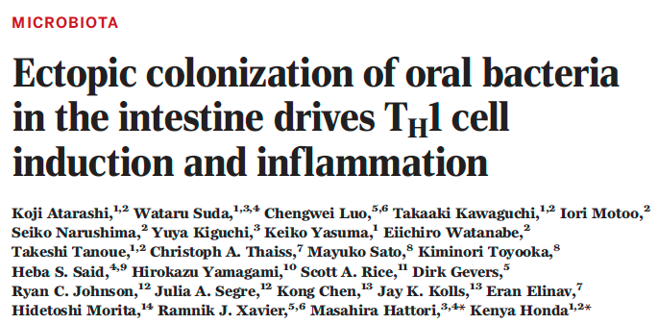
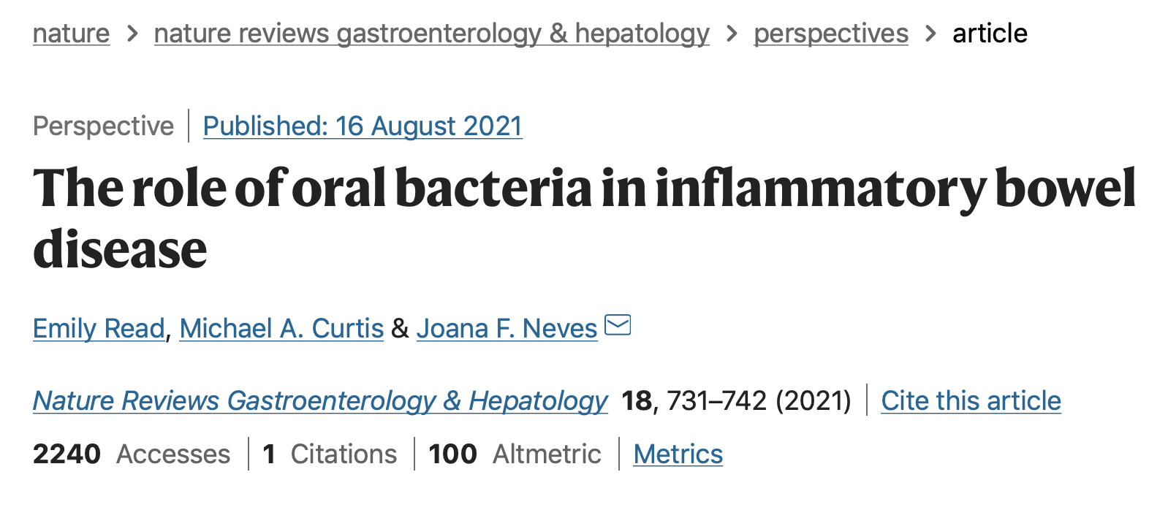
What do we already know about oral-gut transmission?
Very few (<2%) translocation in healthy people
Pathogens translocated from oral cavity stimulates Th1 cells
Relative enrichment of oral bacteria in IBD patients

Slide 7
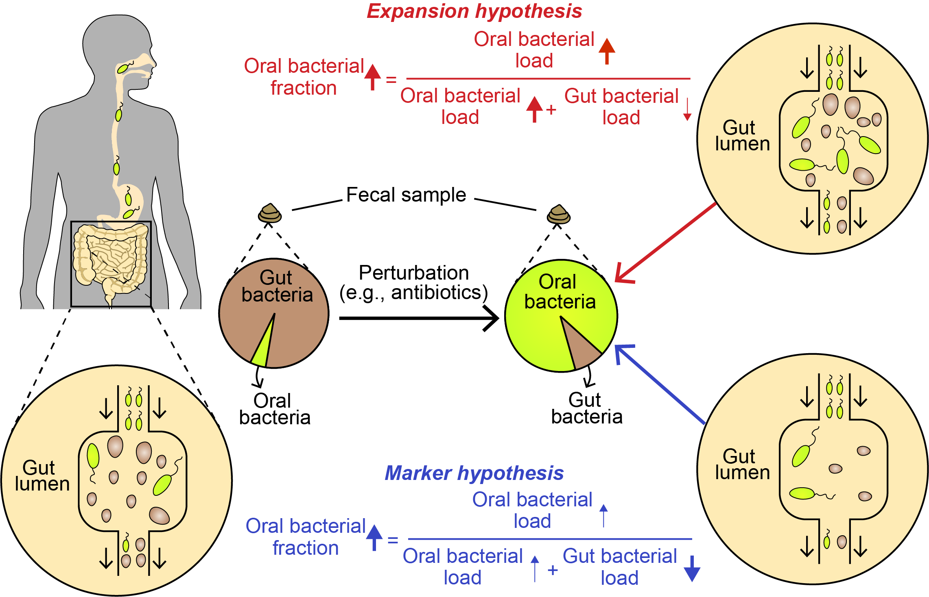
Expansion vs. Marker Hypothesis

Slide 8
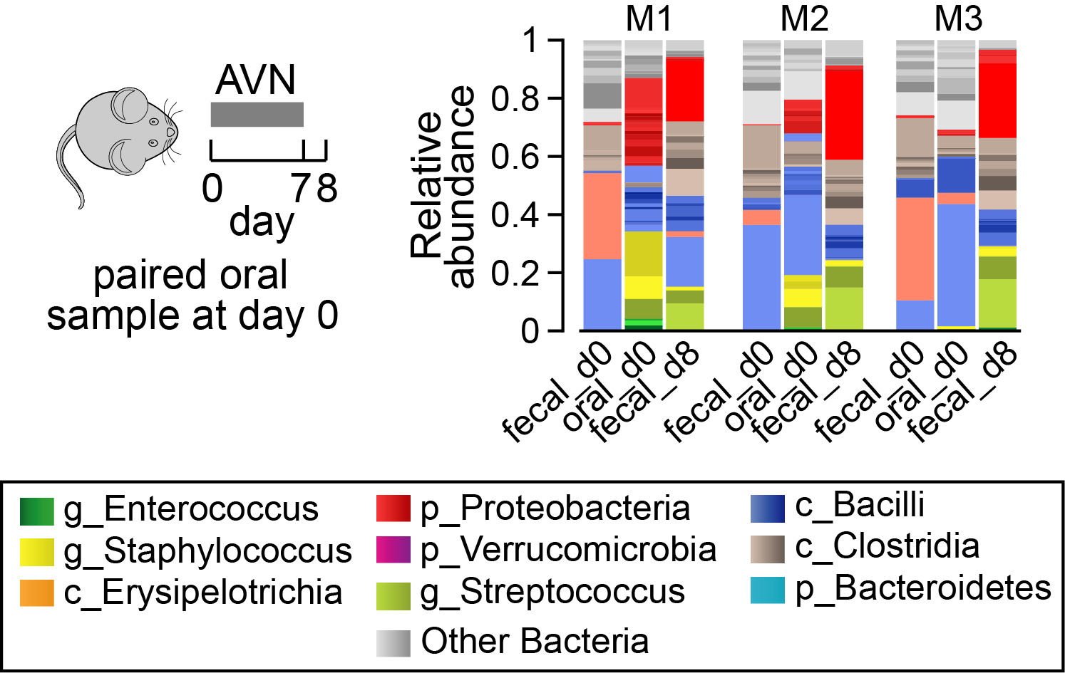
Evidence of oral-gut translocation
By Ana Djukovic

Slide 9
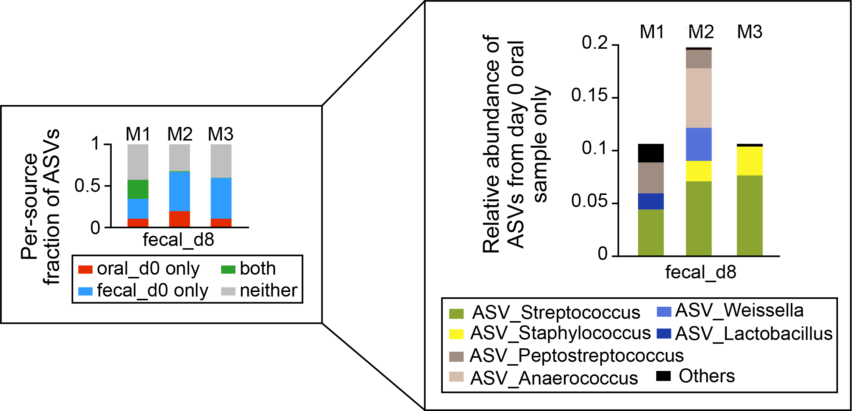
Sources of ASVs in post-treatment feces

Slide 10
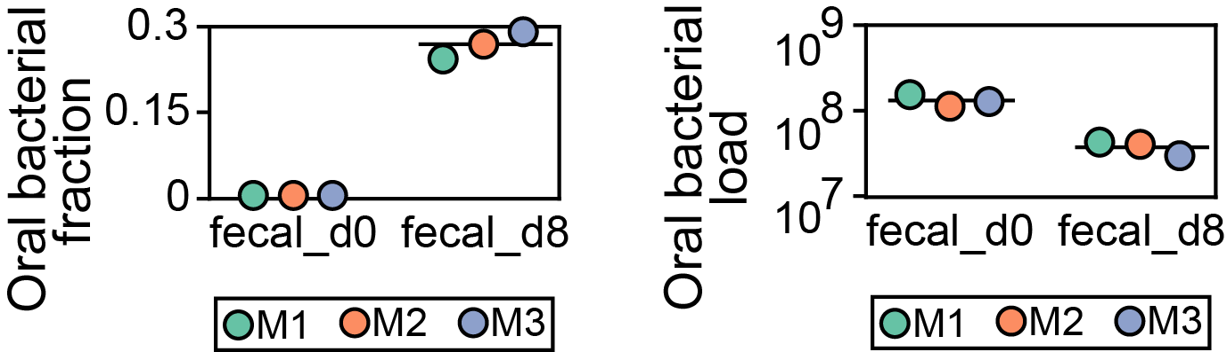
No active expansion of oral populations
Oral-typical ASVs: mean relative abundance > 10⁻⁴ across oral samples and <= 10⁻⁴ across fecal samples

Slide 11
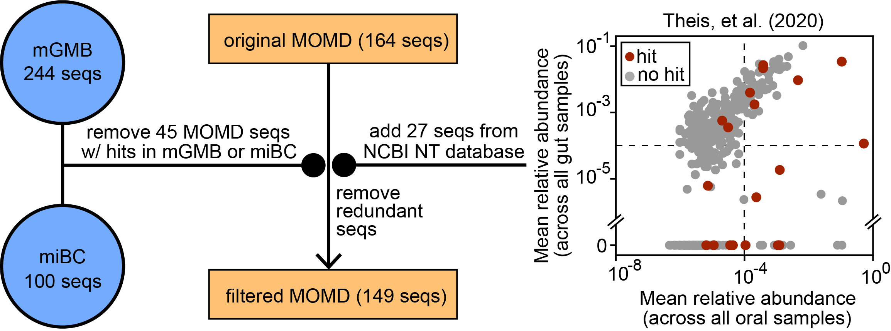
Identifying oral-typical 16S rRNA genes in mouse

Slide 12
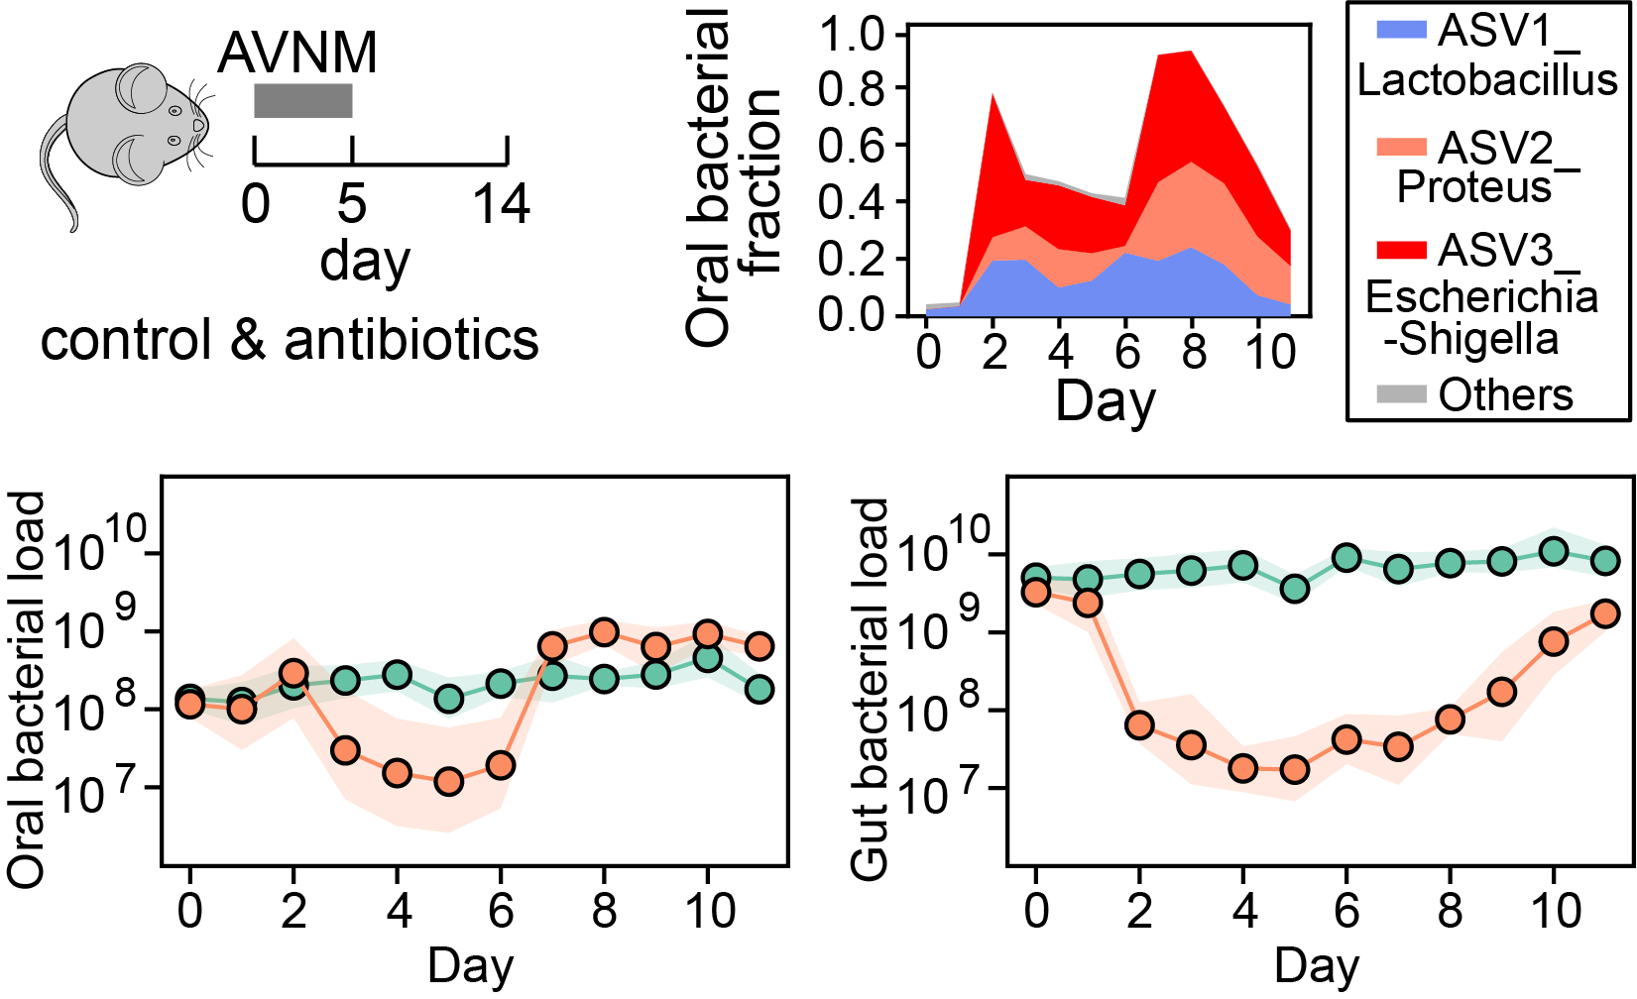
Longitudinal changes of oral bacterial loads in feces

Slide 13
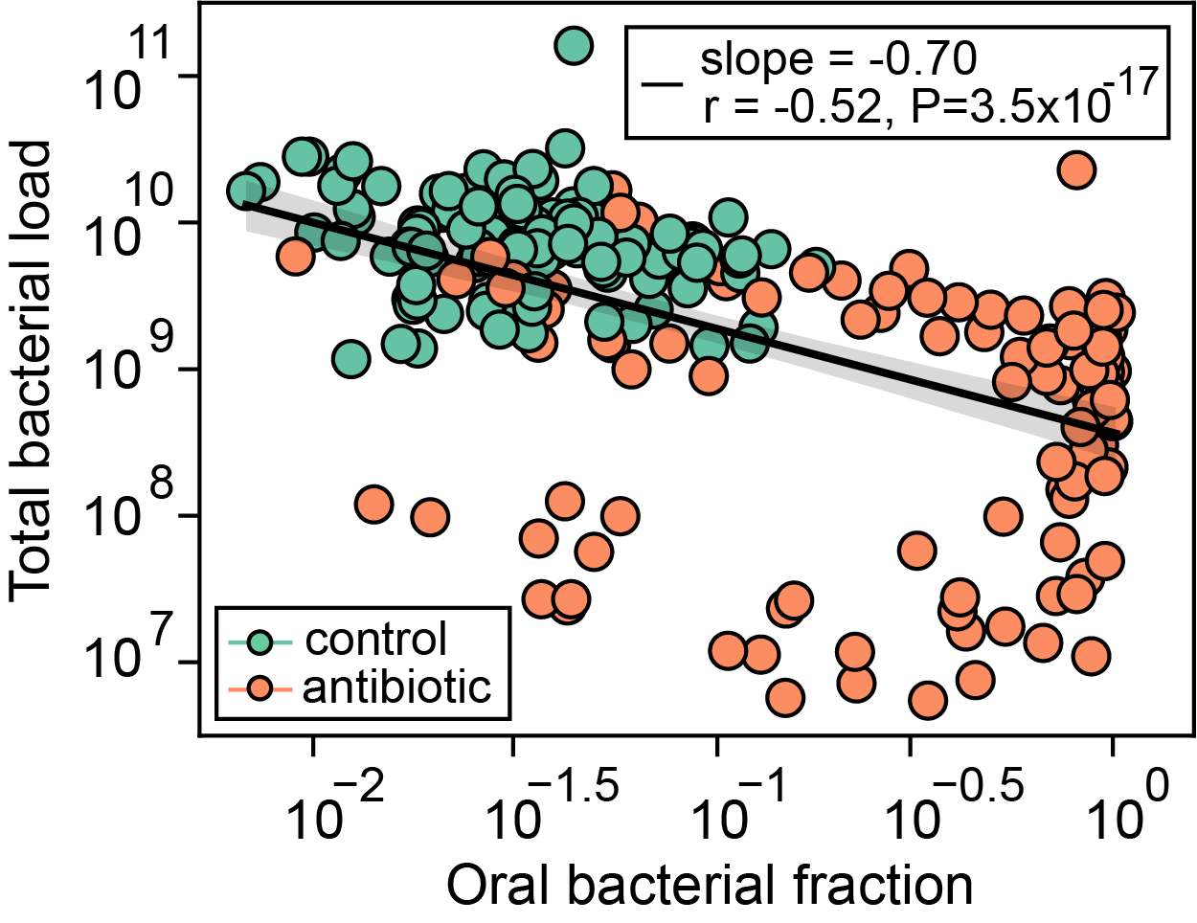
Linear relationship between proportions of oral bacteria in feces and total bacterial loads in mice

Slide 14
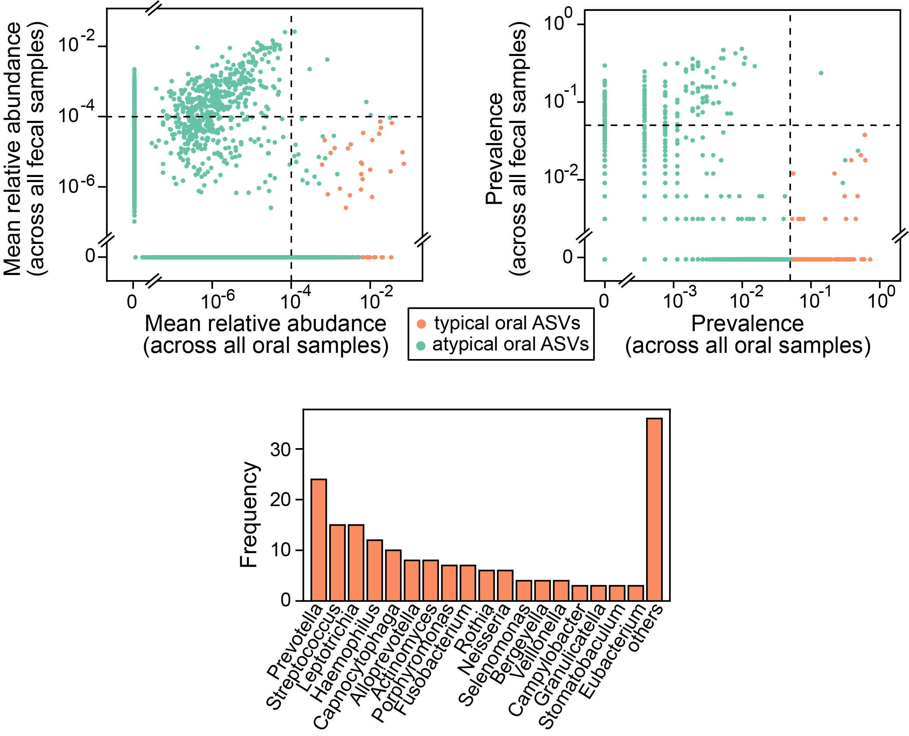
Identifying oral-typical 16S rRNA genes in human

Slide 15
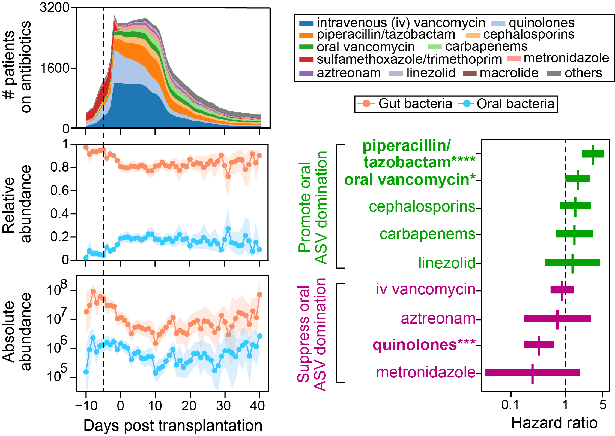
Oral-gut translocation in allo-HCT recipients

Slide 16
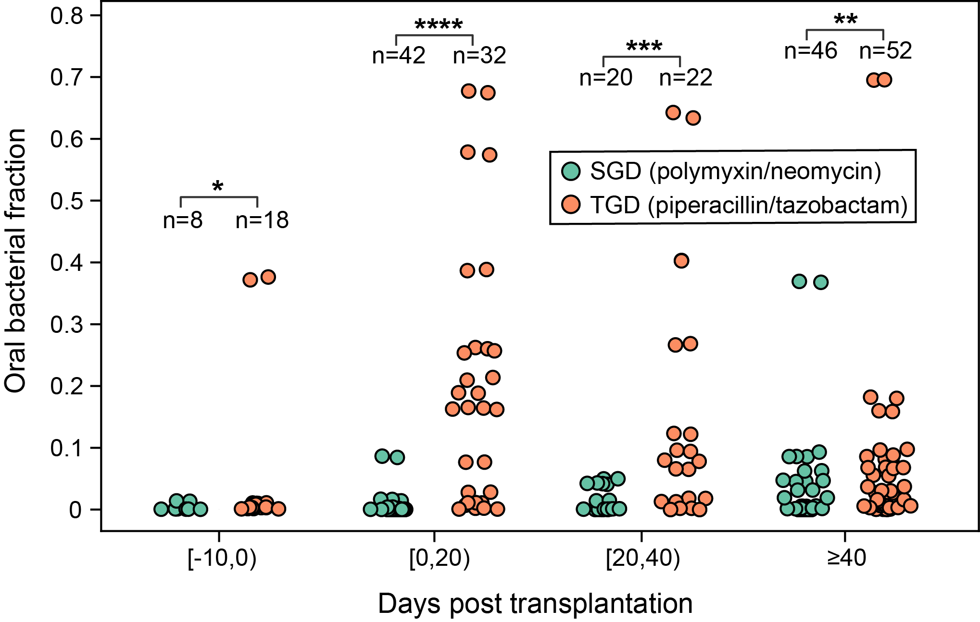
Piperacillin/Tazobactam induces oral ASV domination in pediatric allo-HCT recipients
Bekker, et al., ASBMT, 2019

Slide 17
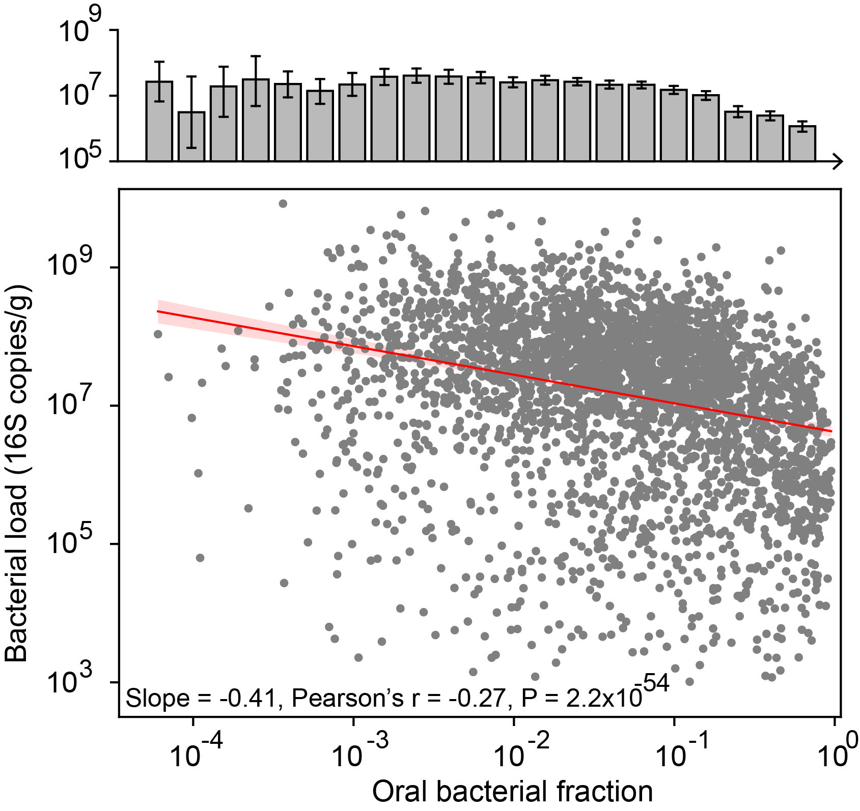
Linear relationship between proportions of oral bacteria in feces and total bacterial loads in humans

Slide 18
A gut colonization resistance model
Density of oral bacteria in the gut lumen
Oral-gut transmission rate
Resource competition
Density of gut bacteria in the gut lumen
Growth rate
Dilution rate
Antibiotic inhibition

Slide 19
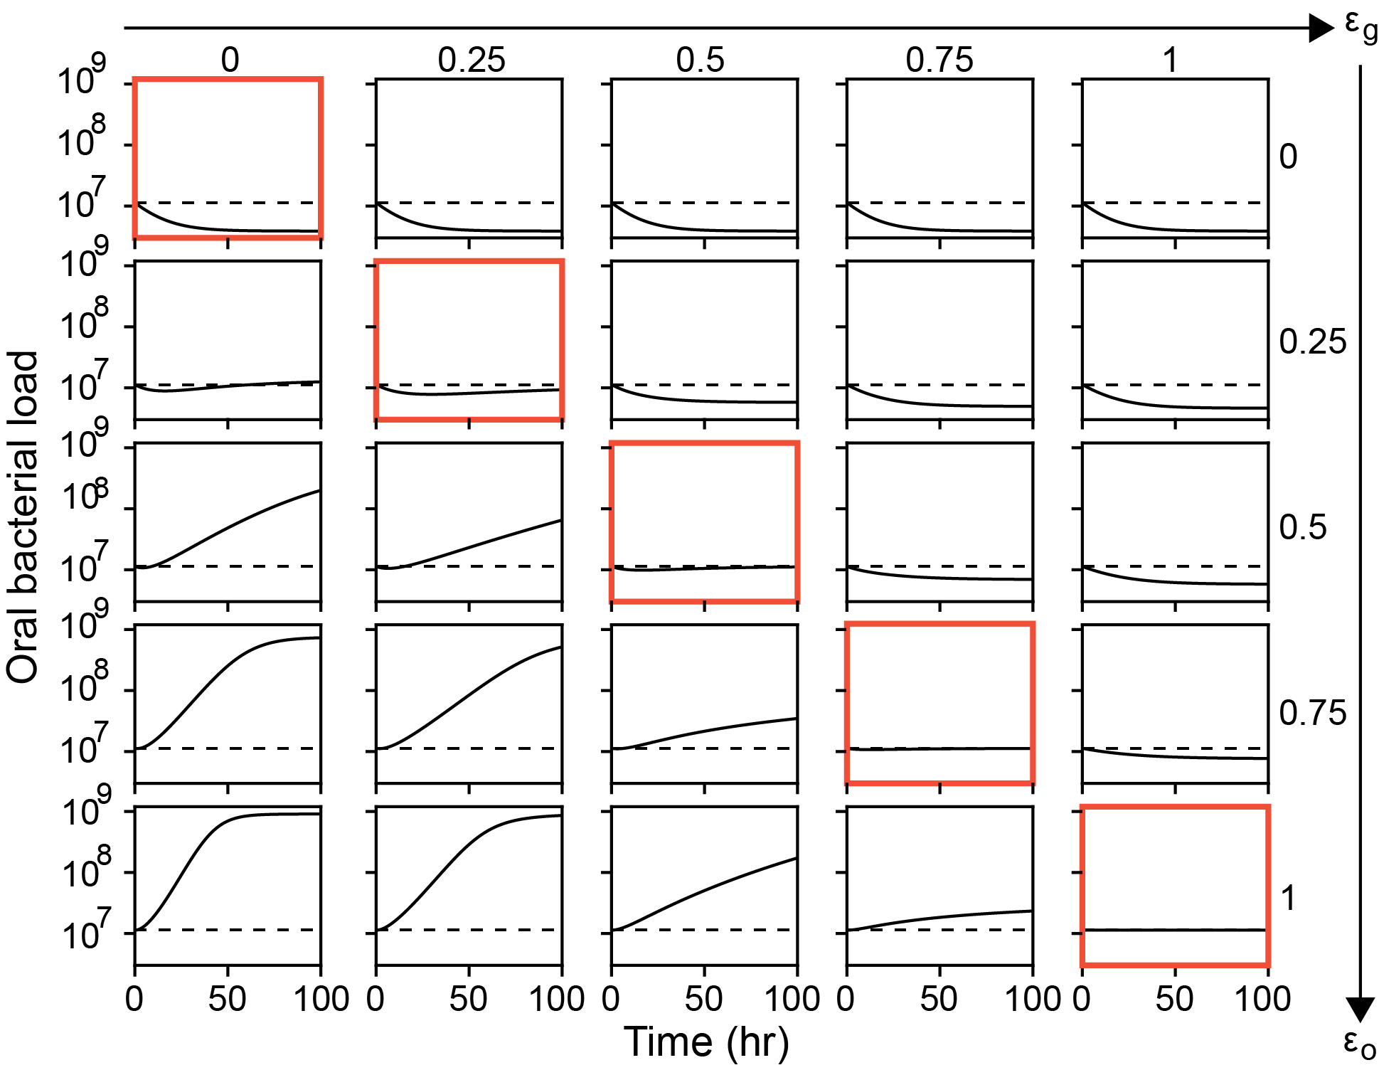
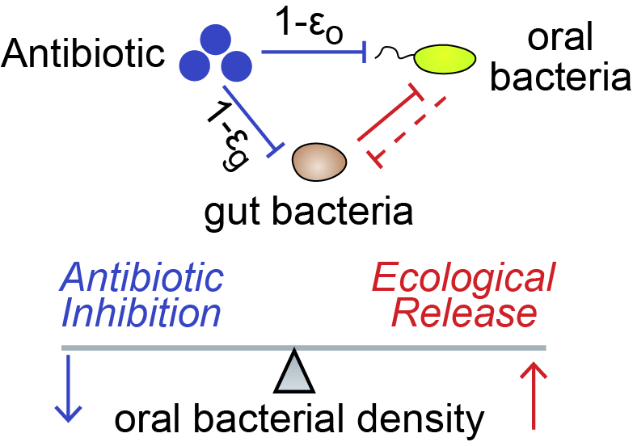
Balance between antibiotic inhibition and ecological release

Slide 20
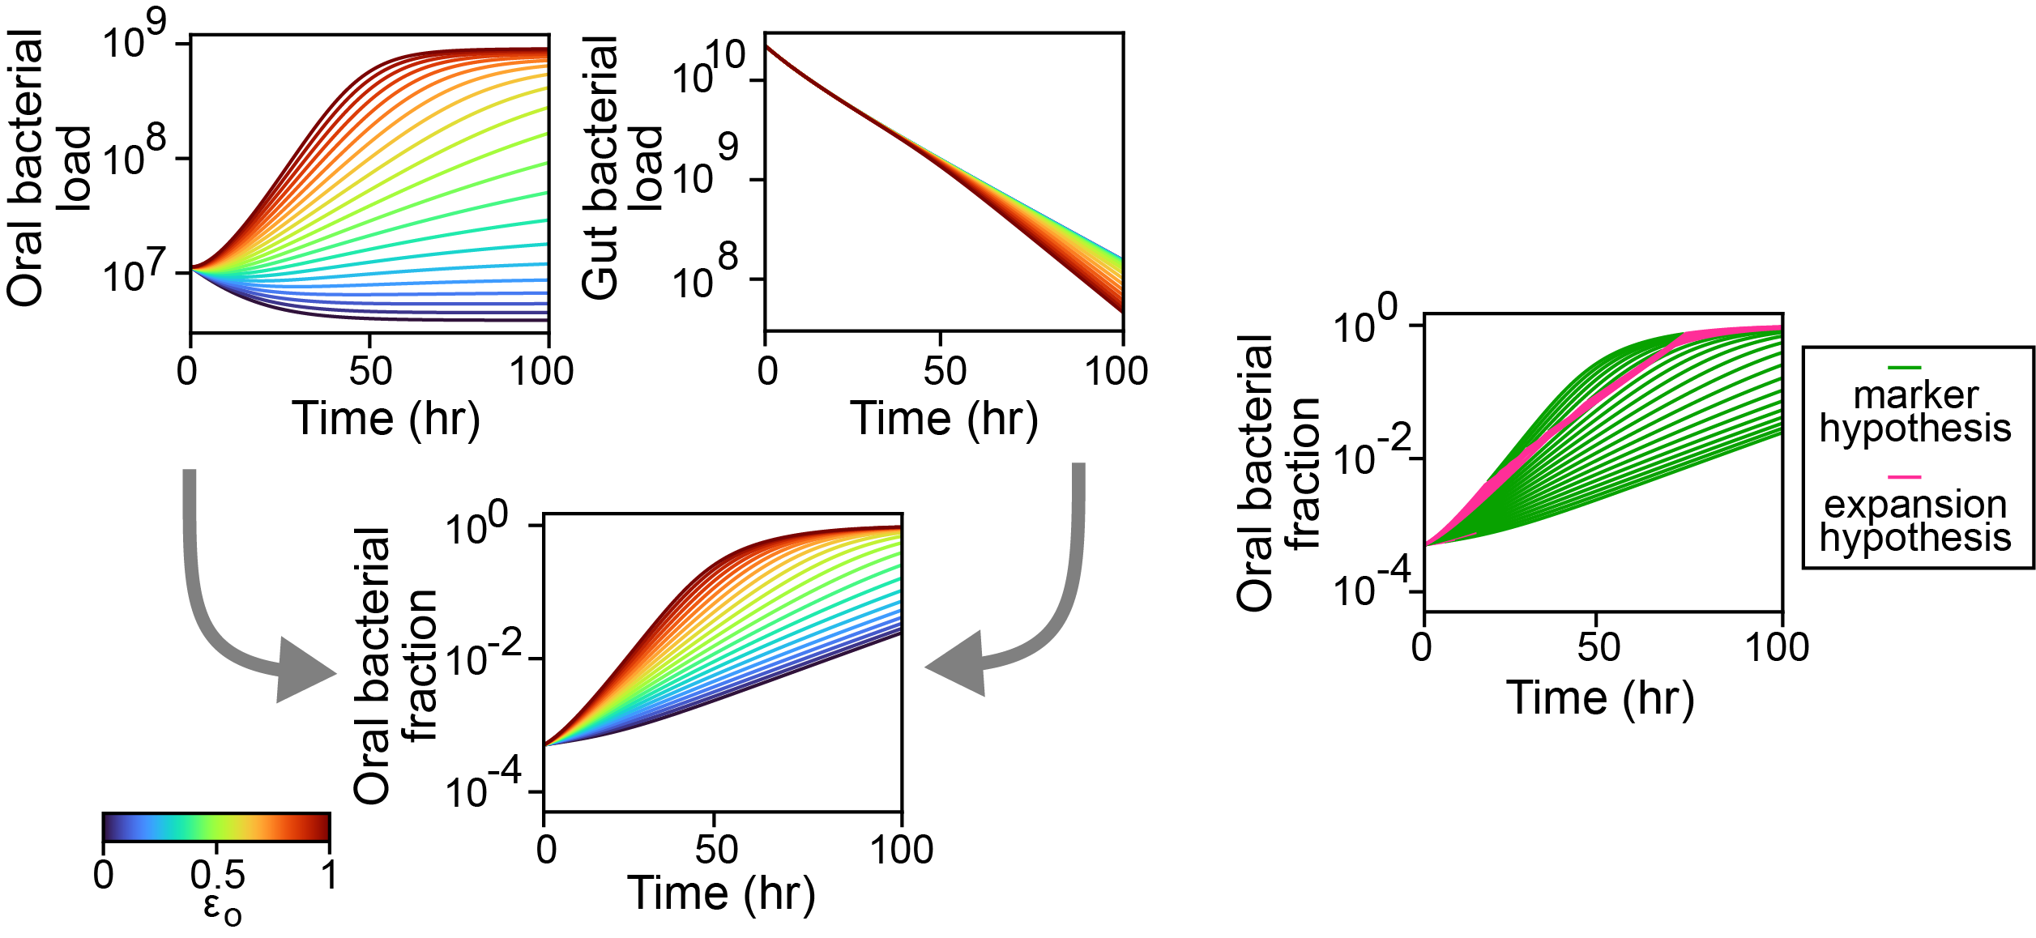
Marker hypothesis at broader conditions

Slide 21
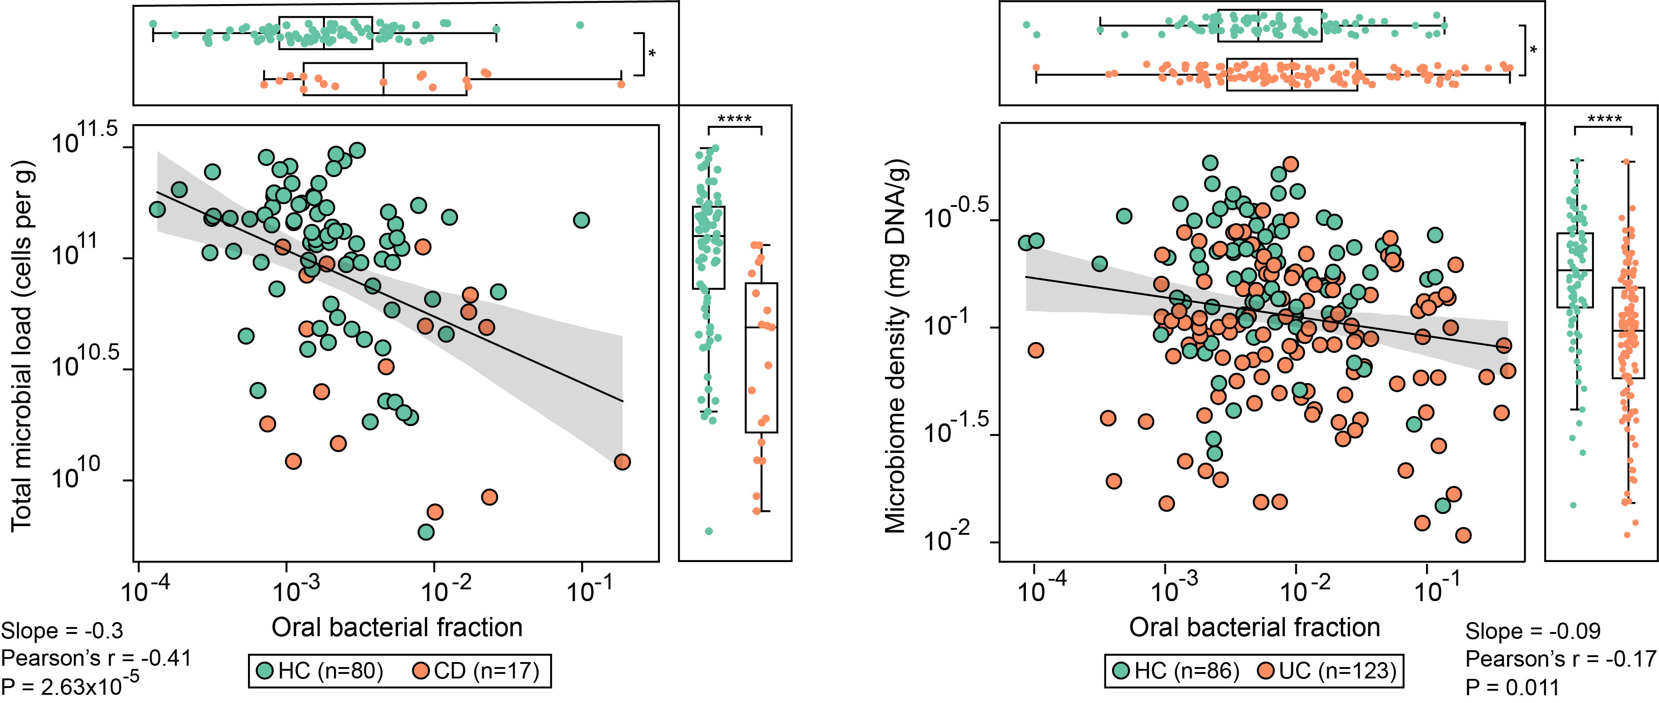
Interconnection between two IBD biomarkers

Slide 22
Take-home messages
Antibiotic (especially piperacillin/tazobactam) induces relative enrichment of oral bacteria in feces of mouse and humans
Oral bacterial loads remains stable under antibiotic treatment , due to a balance of antibiotic inhibition and ecological release effect
Enrichment of oral bacteria in feces is an artifact of relative microbiome profiling; it indicates depletion of gut commensals
Oral bacteria enrichment and low total bacterial loads are interconnected signatures of IBD patients

